Slide 1


Data Challenge 2021
Team 22:
Christine Lin
Lei Gao
Hojin Lee
Katherine Jimenez

Slide 2

The Problem:
Pitney Bowes sells meters to their clients which are vital to their business.
The meters tend to fail from time to time and when they do, they disrupt the business of their clients.
Once a meter fails, client must contact P&B to report the failed meter, so maintenance services team assist with fixing the meter.
The Goal:
To build a model that can predict which meter will fail within the next 7days. So, P&B can schedule the maintenance for the meter and prevent meter from suddenly disrupting client’s business.

Slide 3
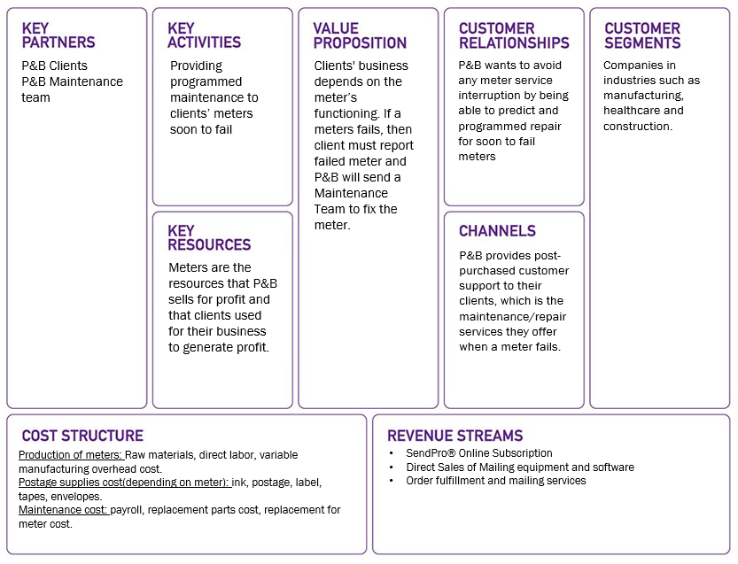
Business Understanding-Lean Canvas

Slide 4
Problem Analysis
The key is to determine what contributes to the failure of meters.
We must identify the features that contribute to the meter’s failure and learn how to estimate their behavior.
By learning the behavior of these features, we will be able to estimated which meter will fail within the next 7 days.
Apart from accuracy, predictive maintenance focus more on precision to decrease False Positive based on the assumption that visiting cost is low.
This is a battery lifetime prediction problem. Our team did some research and found that temperature and voltage are two major factors to battery life. From a business perspective, deployed date and product segmentation which can be inferred from “deviceid” or so, may give us some clues on the prediction.

Slide 5
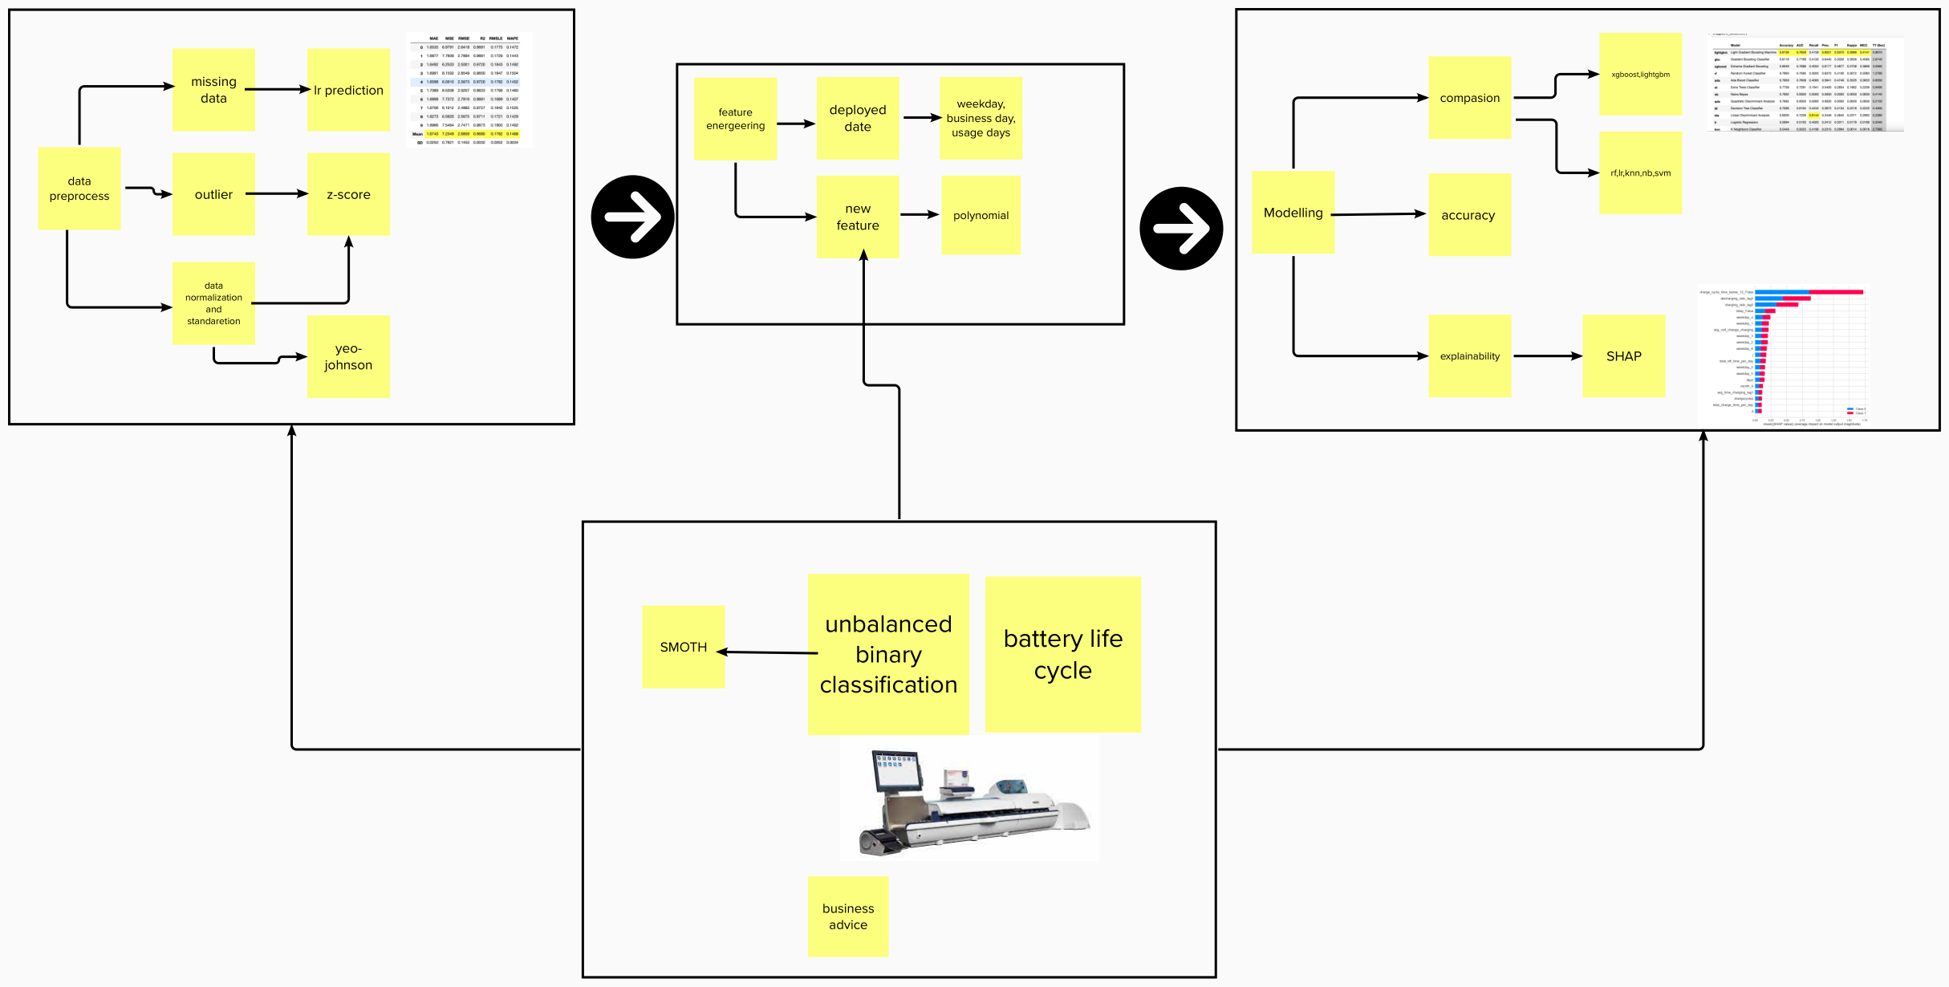
Design Thinking

Slide 6
Exploratory Analysis
After uploading the train dataset, we identified the following:
1) Dataset has 40500 records and 55 columns.
2) Failed meters instances only represent 23% of the data provided for fail_7,
This means that the dataset is unbalanced.
3) Avg_time_dis/charging_lag for more than 10 days account for the majority of missing values.
4) Outliers exists within dataset, however, we run the models with and without outliers and this did not provide
an improvement for our model.
5) Some features are strongly correlated to feature fail_7.
6) Some data are not Gaussian distribution, so normalization process is needed.
Data preprocess and model strategy:
F1 score is important for imbalance data, and a biased model will be performed without oversampling or undersampling.

Slide 7
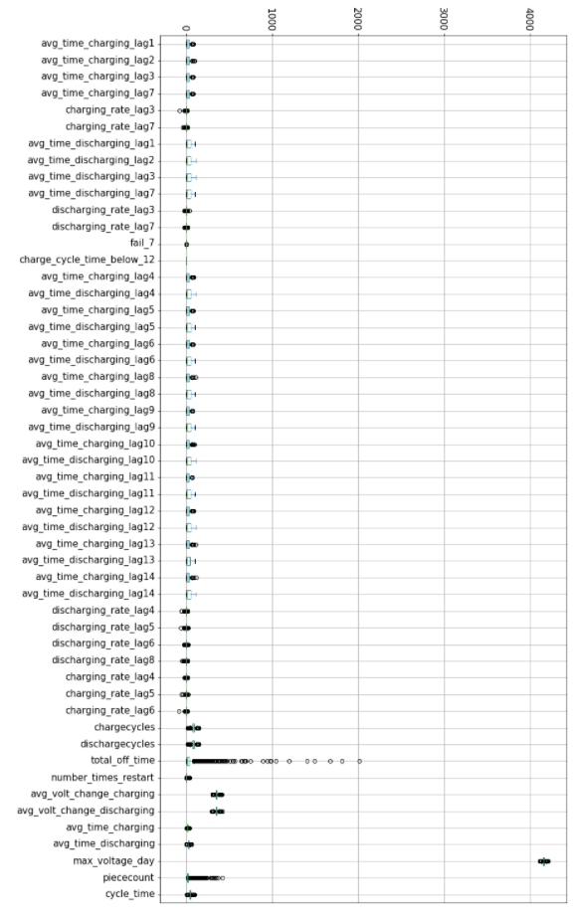
Outliers
We identified many outliers in train dataset.
We removed the outliers to see the effect they will cause in the metrics of the models.
It turned out that removing outliers does not provide any significant improvement to the models’ performance metrics (accuracy, precision, recall and F1 score).
Also, removing outliers will lead to removing values from our dataset which could lead to missing valuable information for our study.
We did not have enough domain knowledge regarding outliers; therefore, we did not want to remove outliers that will then be critical to our model performance.

Slide 8
DATA PREPROCESSING
Normalization & Standardization
Most variables in the dataset have skewed distribution, which means that they do not have a normal distribution. Meaning that the tails of each distribution may act as an outlier to the model.
To fix skewness in train dataset, we applied the normalization technique which changes the values of dataset to a common scale without affecting the difference in the range of the values.
We transformed long tailed data into normalized data.
Missing Values
Train dataset has 33,713 missing values.
To estimate missing values, we used the following methods:
Mean
Median
Previous value by deployed date
Linear Regression
KNN imputer
We found that the best estimator for the missing values is:
Linear regression
*For better performance, we tested using Linear Regression as imputer for missing values.
Pitney & Bowes Data Challenge 2021

Slide 9

Dropping insignificant variables
After creating Net Usage Days variable, we dropped variables:
LastRecord
DateDeployed
We also dropped variable deviceid, which serves as an identifier for each meter (row)

Slide 10

FEATURING ENGINEERING-TECHNICAL METHODS
- PCA -
We applied Principal Component Analysis (PCA) which can improve the performance of the classifier.
We used these two PCA methods:
Linear PCA: which reduces the dimensionality in the data when there is a linear pattern in the decision boundary that separates the two classes, Fail (1) and Non-Fail (0).
RVF Kernel PCA: which reduces the dimensionality in the data when there is a non-linear pattern in the decision boundary that separates the two classes, Fail (1) and Non-Fail (0).
Note: applying PCA (both linear and Kernel) the result we got did not prove improvement to our model’s performance.
To have more insight in the pattern/relationship within the data, we applied the t-Test. By taking a sample from both classes Fail (1) and non-Fail (0).
It turned out that the null hypothesis was rejected.
m₁ ≠ m₂
Note: this means that the pattern between the dataset are not strong by chance but by other elements that we have yet to identify and measure.
- Polynomial- Features
We also tried several polynomial feature methods.
We found that the polynomial_degree = 3 is the best one.
- t Test -
Pitney & Bowes Data Challenge 2021

Slide 11

FEATURING ENGINEERING-BUSINESS METHODS
There are 2 variables in the dataset that by themselves do not provide meaningful information to our model:
LastRecord
DateDeployed
By using LastRecord and DateDeployed, we calculated variable Net Usage Days, which provides the total amount of days that the meter has been functioning since its deployment.
We also created new features such as:
is_business_day
Weekday
Month
based on DateDeployed.
CREATING NEW VARIABLES
Pitney & Bowes Data Challenge 2021

Slide 12

BUILDING, TRAINING & COMPARING ML MODELS
Models & Platforms
Models:
Light Gradient Boosting Machine
Random Forest Classifier
Gradient Boosting Classifier
Ada Boost Classifier
Extra Trees Classifier
Decision Tree Classifier
SVM Linear Kernel
Logistic Regression
Linear Discriminant Analysis
Ridge Classifier
K Neighbors Classifier
Naïve Bayes
Quadratic Discriminant Analysis
H2OStackedEnsemble
Model platforms:
Pycaret
H2o
sklearn
fast.ai
*We used cross validation method to make our model more stable and robust.
To handle imbalance data we tried:
SMOTE
SMOTHEENN
TomekLinks
EditedNearestNeighbors
SMOTETomek
We got the best result with technique SMOTE.
However, after dividing train dataset, apply SMOTE and training the model we noticed that:
SMOTE is practical to handle imbalance data.
Pitney & Bowes Data Challenge 2021
Notes:
However, after dividing our data we applied SMOTE and realized through the validation set that: SMOTE does not take into consideration neighboring samples that can be from the other class. This can increase overlapping and add additional noise to the data.

Slide 13

MODEL EVALUATION

Slide 14
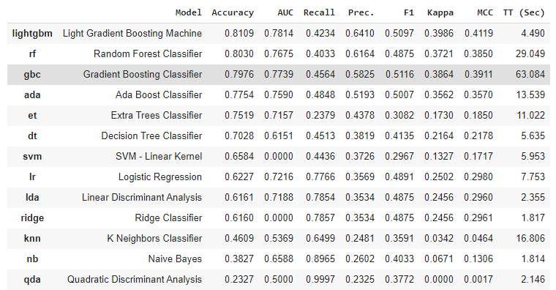
Pycaret Platform performance
Notes:
Decision tree (not suitable for imbalance data)
Random Forest: build based on decision trees and is highly sensitive to imbalance data.
XGBoost: is a gradient boosted decision tree model with scale_hyper_parameter which is highly useful to deal with imbalance data.
LightGBM: is a gradient boosted decision tree based on learning algoritms.
DeepLearning: is a ML method based on AI networks that are capable of learning unsupervised from unstructured and unlabeled data.
Quadratic Discriminant Analysis (QDA): statistical method that finds quadratic combination of features that represent or separate 2 or more classes.

Slide 15
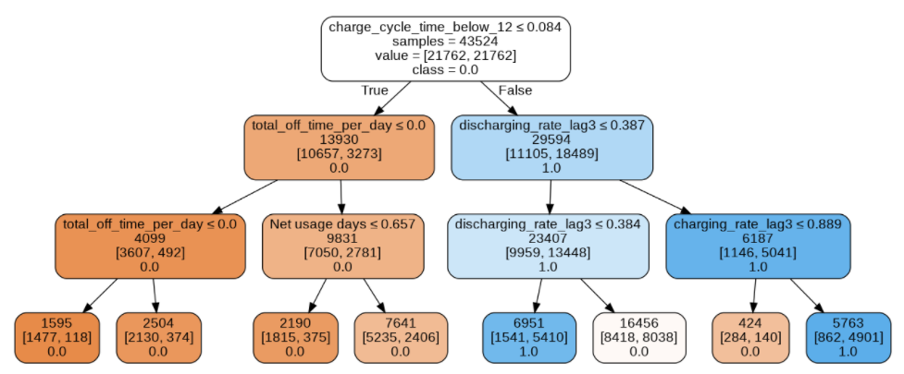

Decision Tree
We ran the Decision Tree in depth 3 after SMOTE and found the following.
Notes:
Depth 3 provided higher F1 score than depth 5.
The opposite happens in term of accuracy, in which depth 5 provides higher accuracy than depth 3.
In term of imbalance data, F1 score and precision are more reliable metrics to measure a model’s performance.
Therefore, in this case Decision Tree depth 3 provides a more reliable

Slide 16
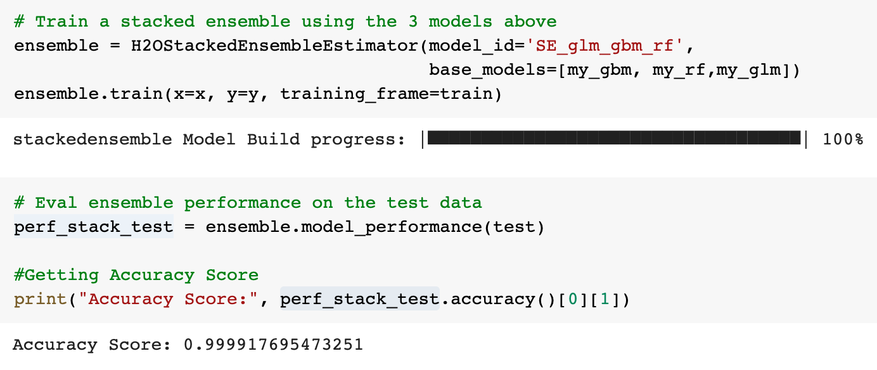
H2O Stacked Ensemble
Using H2O ensemble, we built and stacked 3 different models: Generalized linear modeling, gradient boosting machine, and random forest. We were able to derive an accuracy score only from this model.
Notes:
Depth 3 provided higher F1 score than depth 5.
The opposite happens in term of accuracy, in which depth 5 provides higher accuracy than depth 3.
In term of imbalance data, F1 score and precision are more reliable metrics to measure a model’s performance.
Therefore, in this case Decision Tree depth 3 provides a more reliable

Slide 17
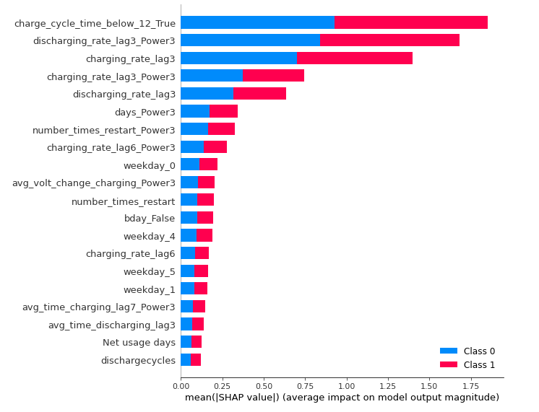
Explainability: SHAP Graph
As shown in the feature importance diagram using Shap, we conclude that the top 5 features indicating a likelihood of a failed meter are the followings:
charged cycle time below 12
discharging rate lag3 power3
charging rate lag3
charging rate lag3 power3
discharging rate lag3
Therefore, charged cycle time below 12 is the most important factor that affects the failure of a meter. Additionally, charging and discharged rate for the previous 3 days have significant impact as well.
These features are consistent with decision tree model.
Notes:
Depth 3 provided higher F1 score than depth 5.
The opposite happens in term of accuracy, in which depth 5 provides higher accuracy than depth 3.
In term of imbalance data, F1 score and precision are more reliable metrics to measure a model’s performance.
Therefore, in this case Decision Tree depth 3 provides a more reliable

Slide 18
Model Compasion
Models | Accuracy | F1 score | Explainability | Runtime
LightGBM | 81% | 51% | Low but SHAP | Low
Decision Tree | 79% | 50% | High | Low
H2O | 99% | -% | Low but SHAP | Medium

Slide 19
Business Conclusion
Based on our study of the data, the model's performance and the SHAP graph, we conclude that business wise:
Pitney and Bowes can estimate which meters will fail within 7 days by using the features below. By doing so, P&B will be able to identify the meters that will fail, provide scheduled maintenance to meter fails and avoid the customer’s business to be interrupted.
Charge Cycle time below 12
Discharging Rate by day 3
Charging Rate by day 3
Number days in use
Number of times that meter restarts
These features are critical to determine which meters will be failing in the next 7days.
Notes:
Depth 3 provided higher F1 score than depth 5.
The opposite happens in term of accuracy, in which depth 5 provides higher accuracy than depth 3.
In term of imbalance data, F1 score and precision are more reliable metrics to measure a model’s performance.
Therefore, in this case Decision Tree depth 3 provides a more reliable

Slide 20
Recommendations
We believe that our model can be improved by adding additional features which were not covered in the dataset. For example, Temperature is also a critical feature that could add valuable information to the model.
We can customize the models based on business requirement with threshold adjustment. For example, decrease false positive but increase false negative.
Notes:
Depth 3 provided higher F1 score than depth 5.
The opposite happens in term of accuracy, in which depth 5 provides higher accuracy than depth 3.
In term of imbalance data, F1 score and precision are more reliable metrics to measure a model’s performance.
Therefore, in this case Decision Tree depth 3 provides a more reliable

Slide 21

THANK YOU

